Slide 1
Pay And Park
E-Parking – Made Parking Easy…

Slide 2
Project Members
Devam Shah - Back-End
Shudhanshu Khanduri - Back-End
Prajakta Ghadghe - Front-End
Akshay Fegade - Front-End
Anurag Kharche - Front-End

Slide 3
*Technologies Used*
Programming Languages :-
Java (Spring Boot)
JavaScript
MySQL
Markup Languages :-
HTML
CSS

Slide 4
Features Of E-Parking
Register and login
Three types of users
Secure payment gateway
Create Car Parks and Parking Spaces
View/delete/update bookings
Anti double-booking
View metrics for the Parking Owner
View metrics for the Site Administration
Submit a request to refund/update a booking to the parking owners
View the request/message sent from the driver and vice versa from the parking owner
Create parking owner accounts by the site administrators
Being able to disable accounts
Easy To Use.

Slide 5
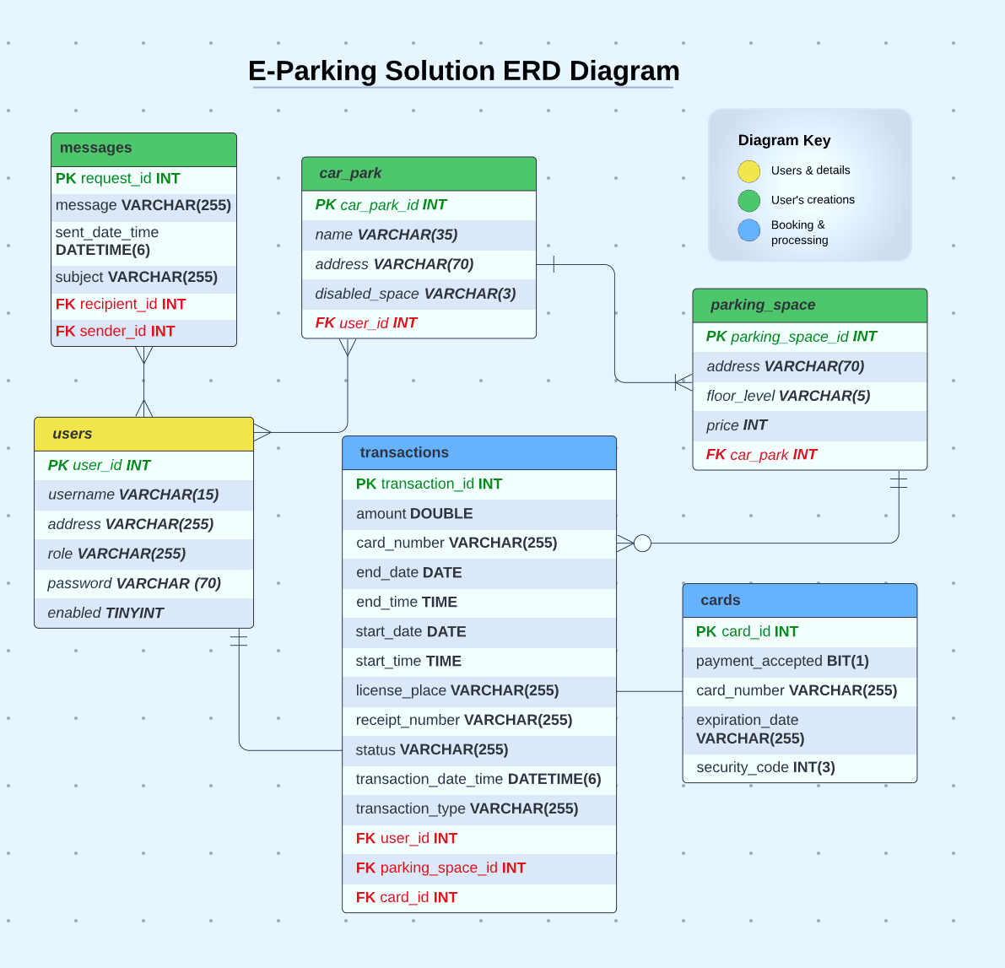
ERD Diagram
This ERD diagram represents the entities and relationships of the E-Parking Solution database.

Slide 6
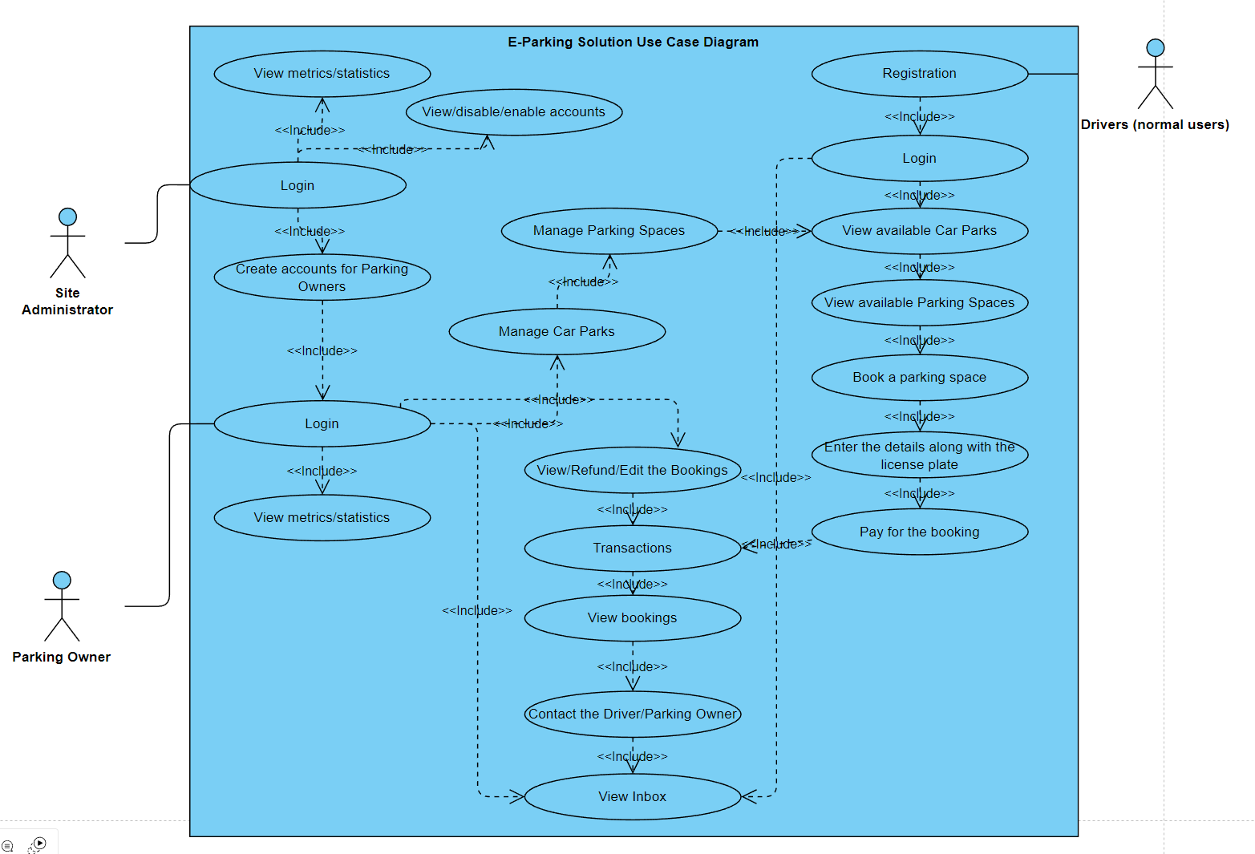
Use Case Diagram

Slide 7
Spring Boot Framework 2.7.4
MySQL Server 8.0.31
Maven 3.8.1
*Pre-requisites*
Dependencies
Spring Security
Spring JPA
Spring Starter Web
Thymeleaf
JUnit testing
MySQL Connector

Slide 8
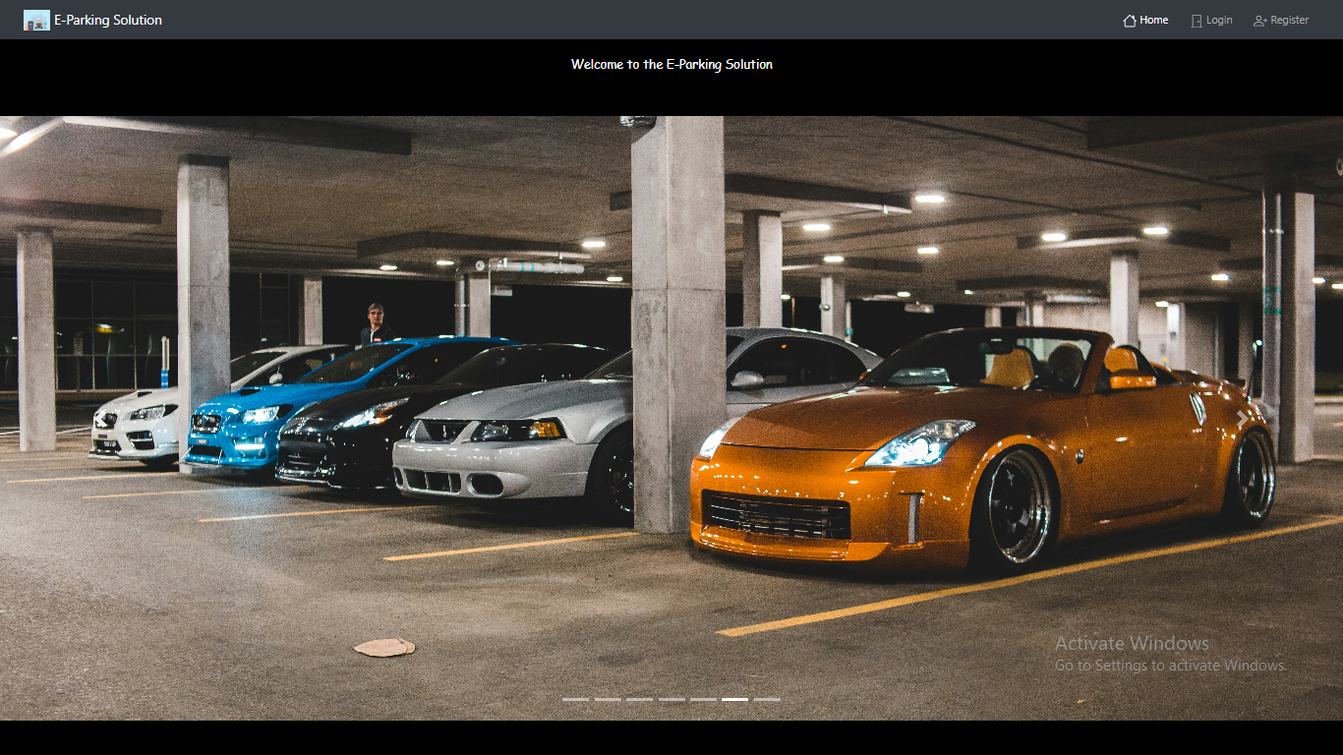
Landing Page/HomePage
It Includes :-
Home, Login & Register Buttons
As Well As Some Sliding Images For Looks

Slide 9
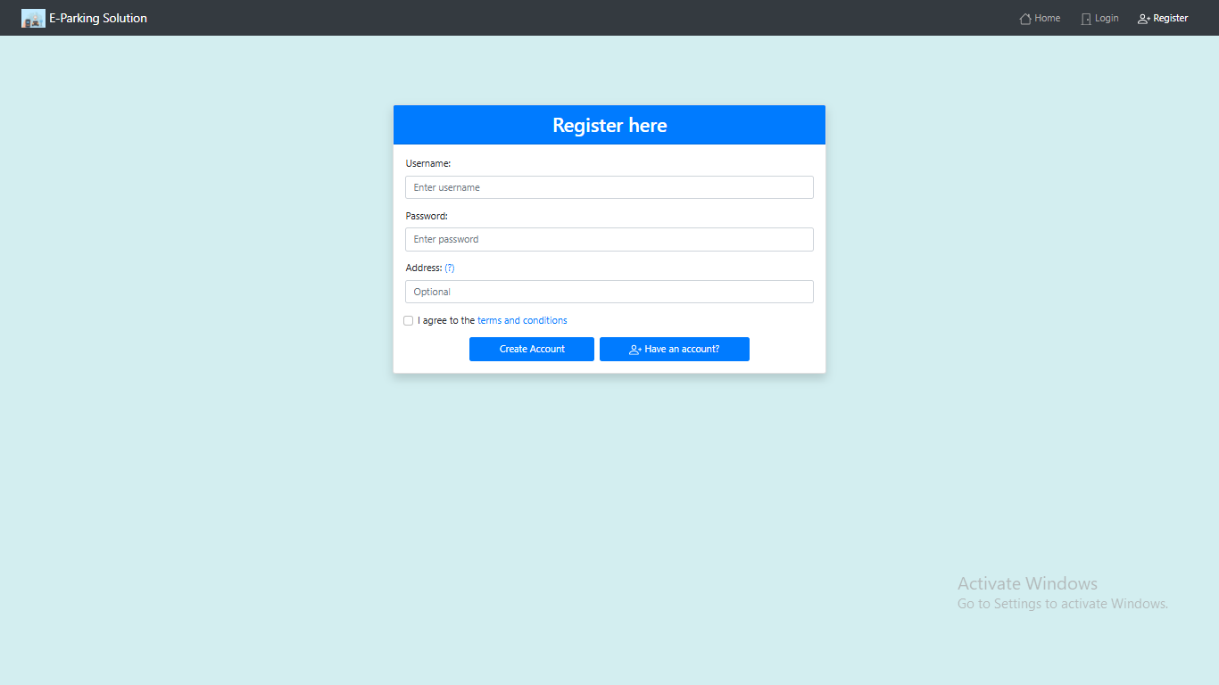
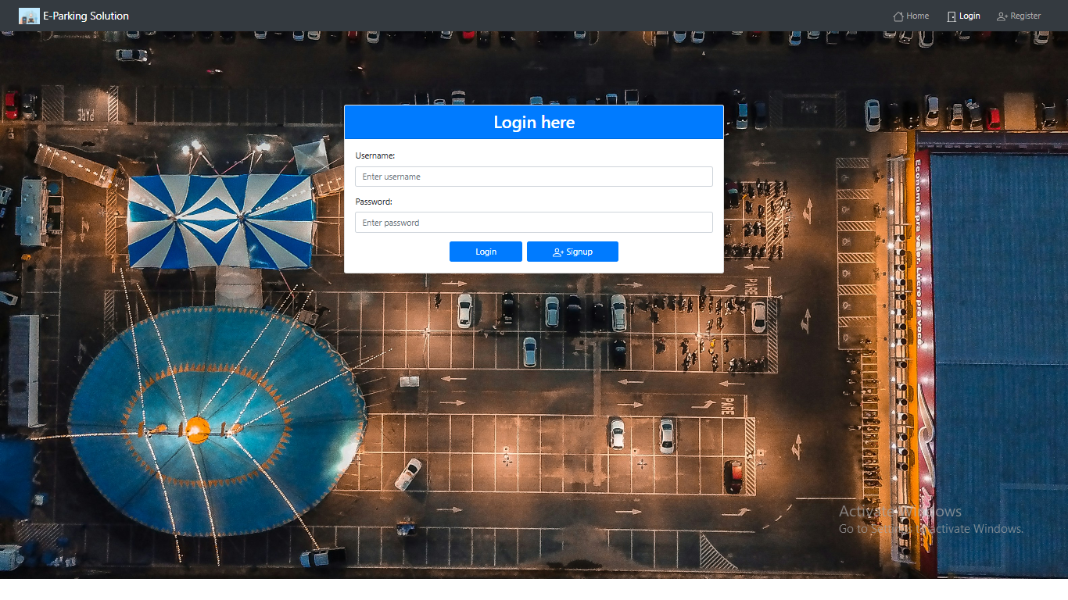
Login & Register
If The User Is New He Can Register And Then Login

Slide 10
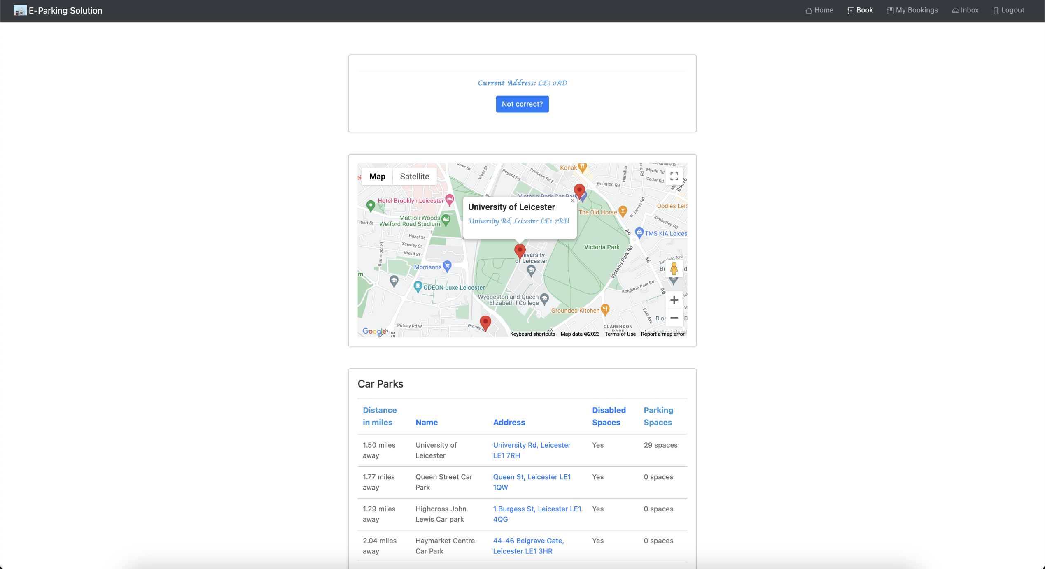
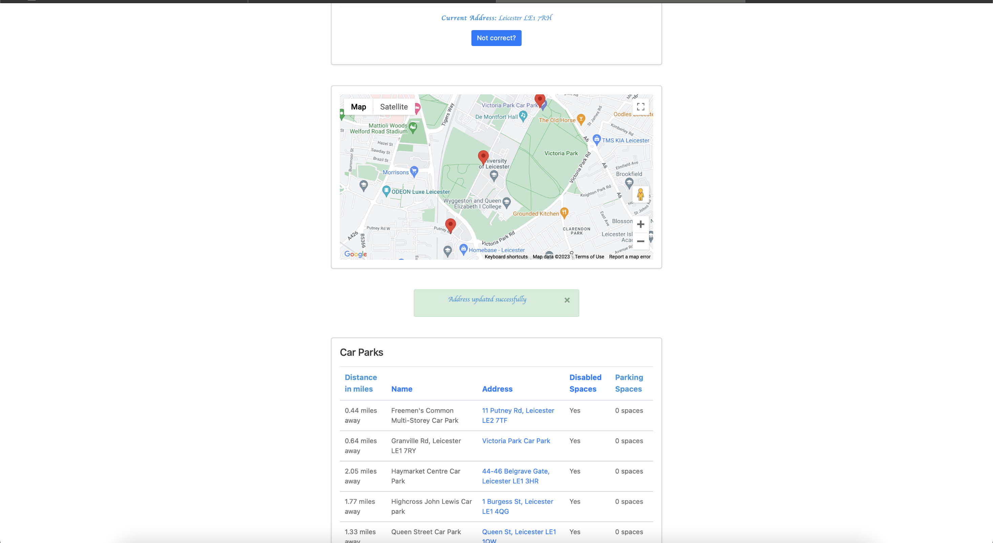
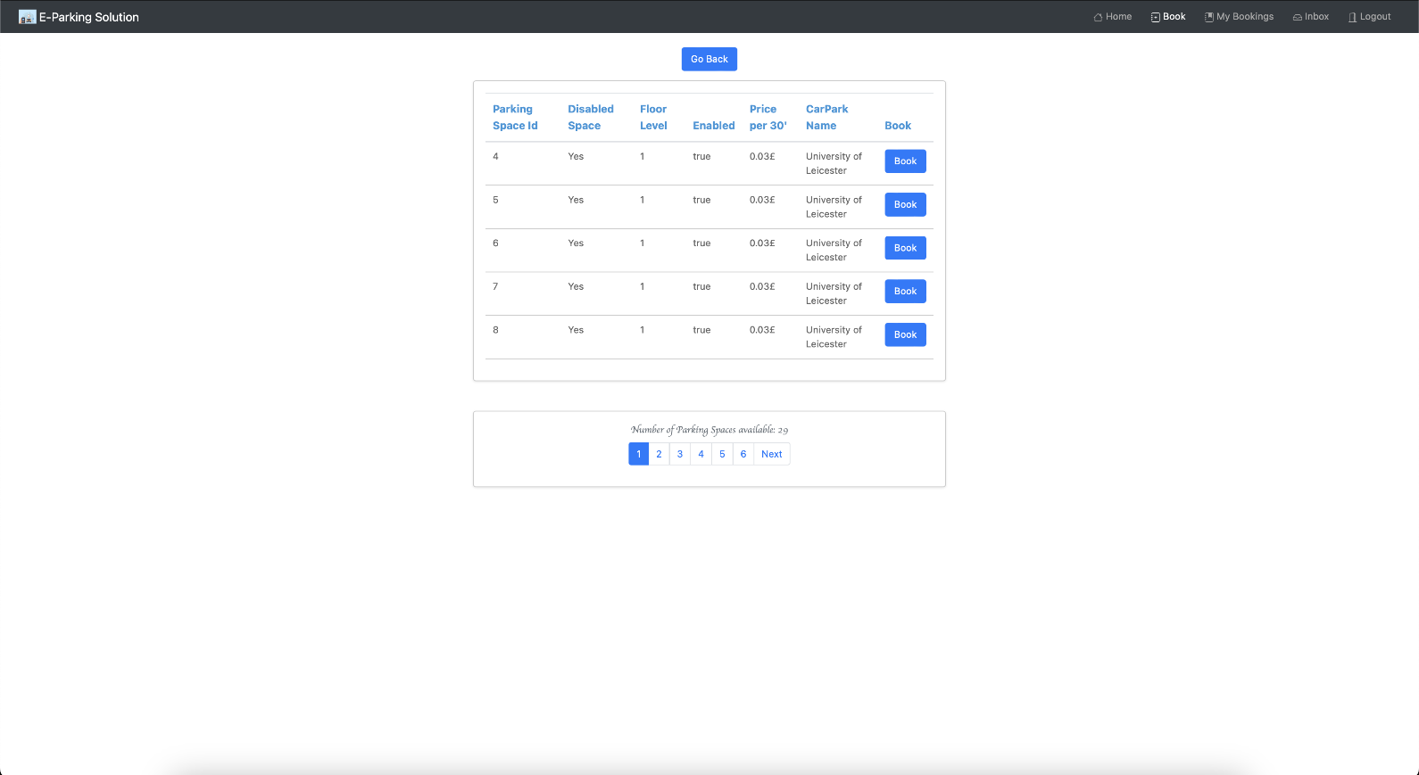
Booking Page

Slide 11
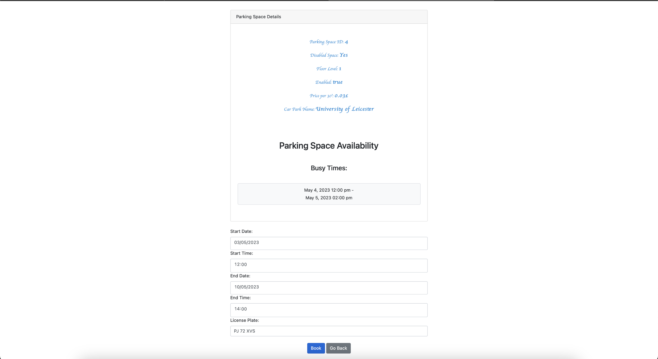
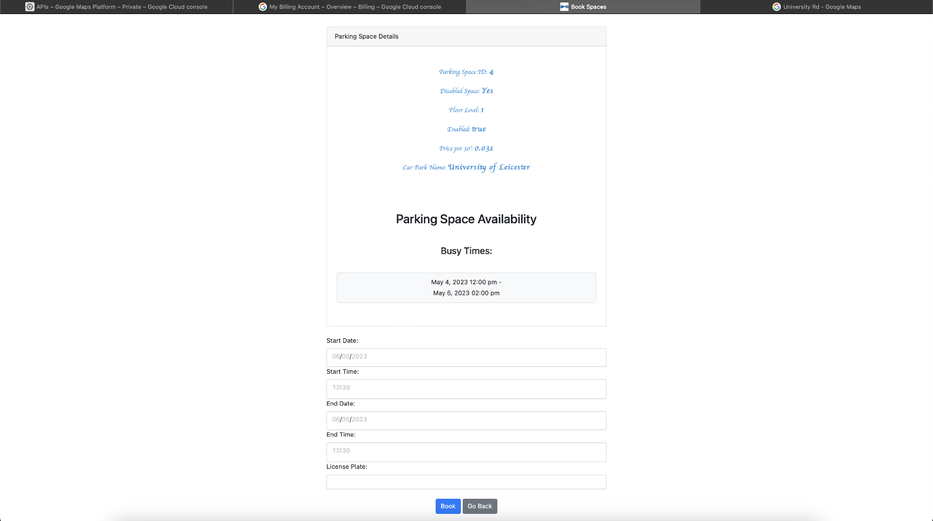

Slide 12
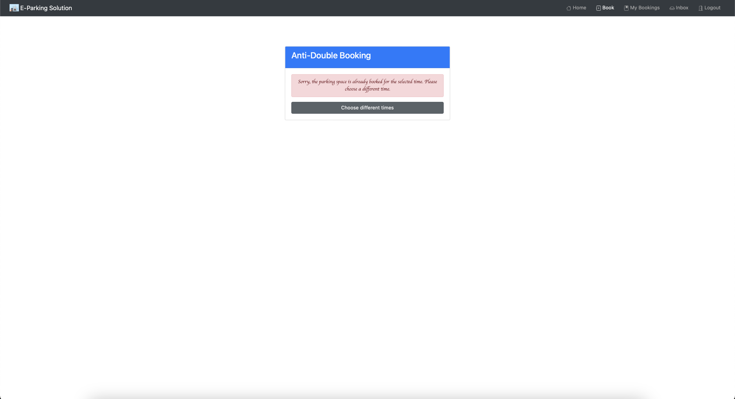
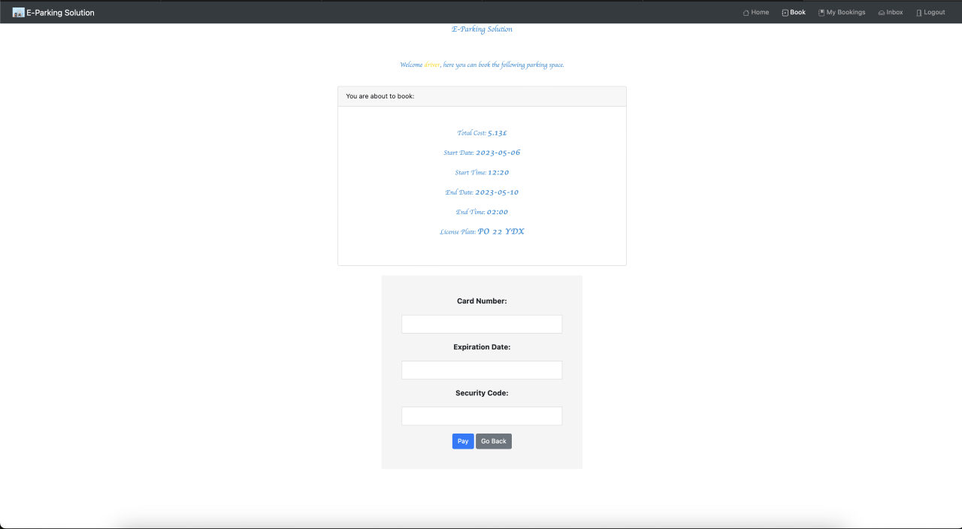
Payment

Slide 13
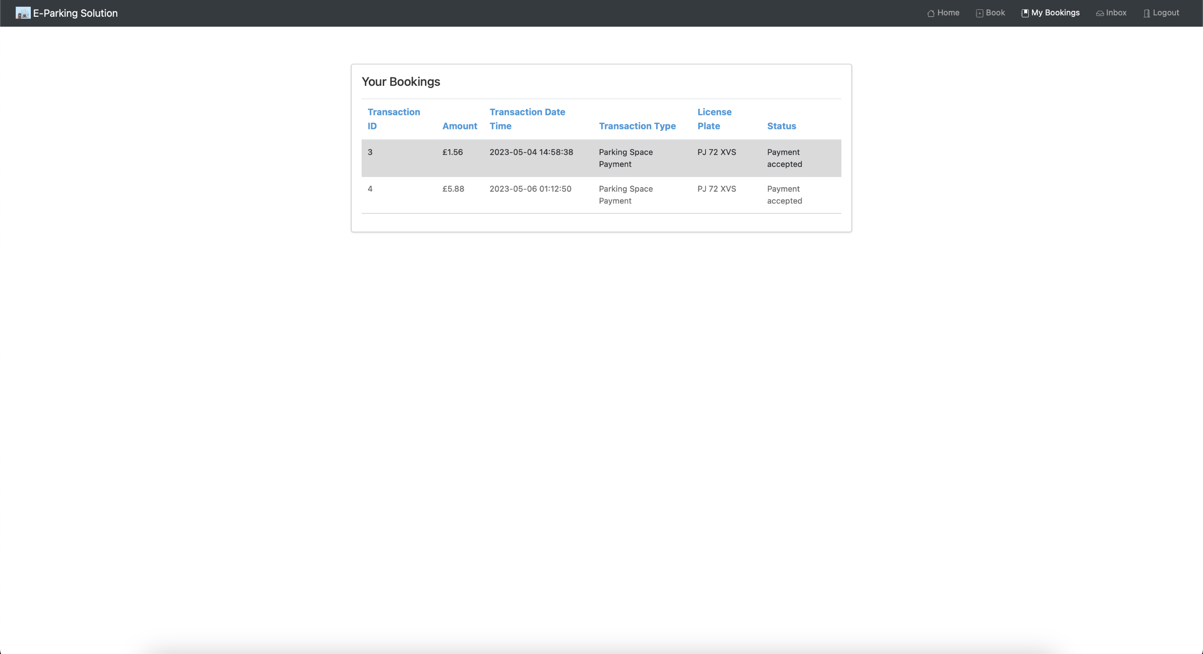
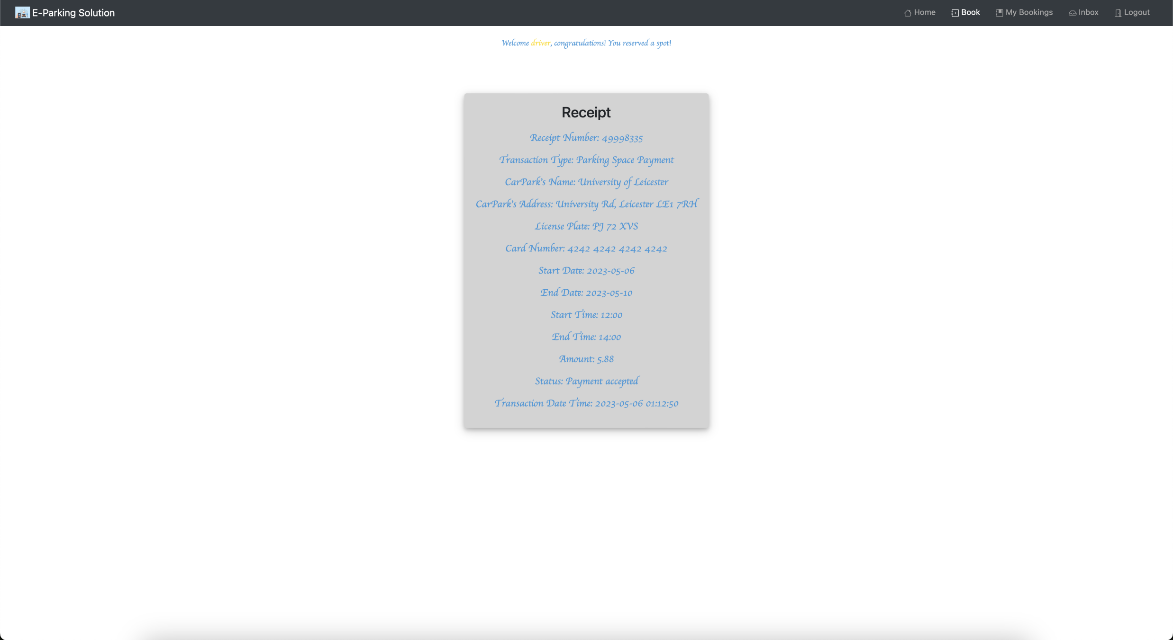
Payment Receipt
View Bookings

Slide 14
Creating Parking Owner

Slide 15
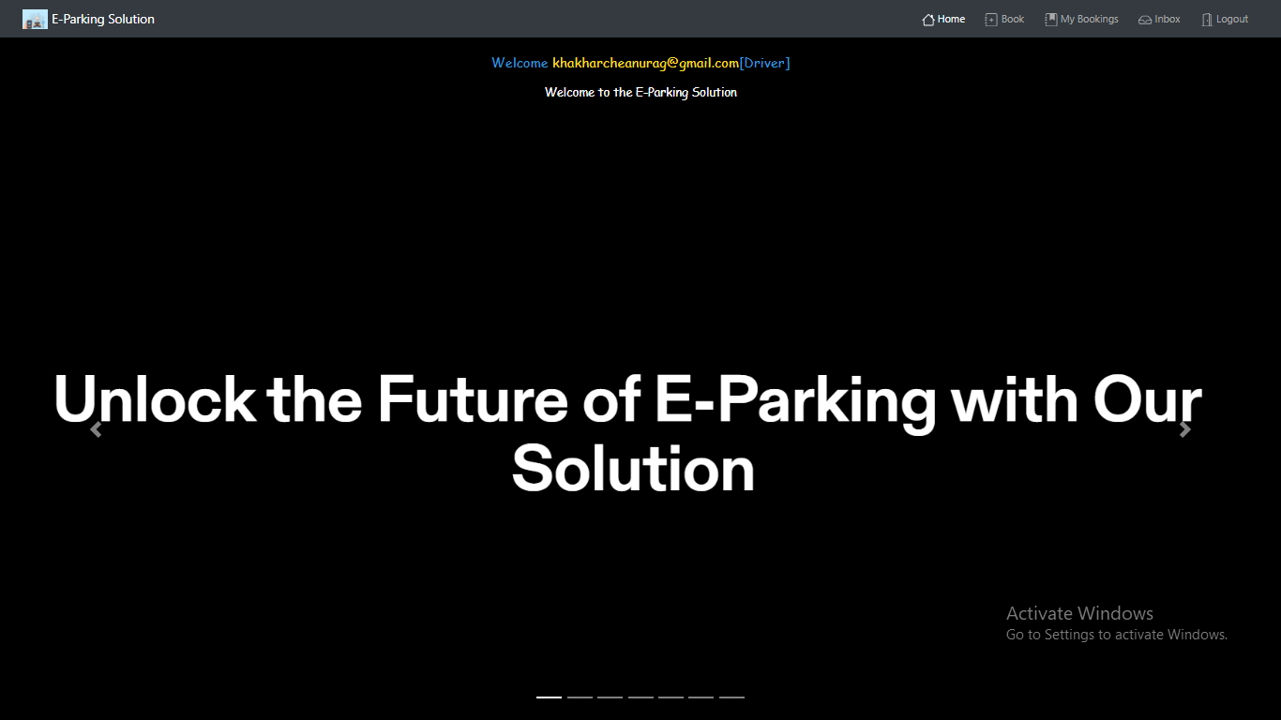
Driver Login

Slide 16
Booking

Slide 17
PayMent

Slide 18
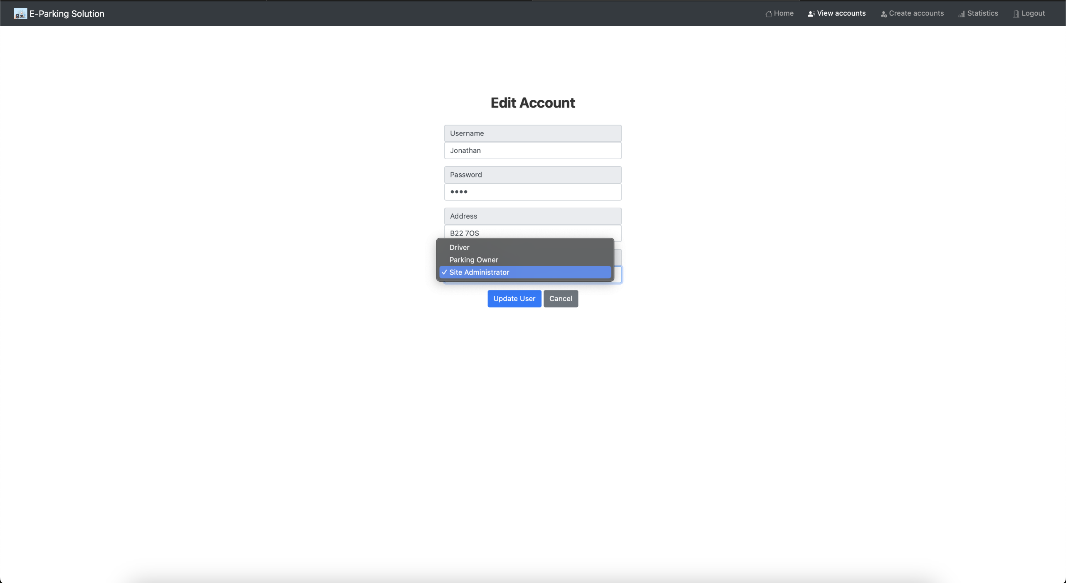
Disable Account

Slide 19
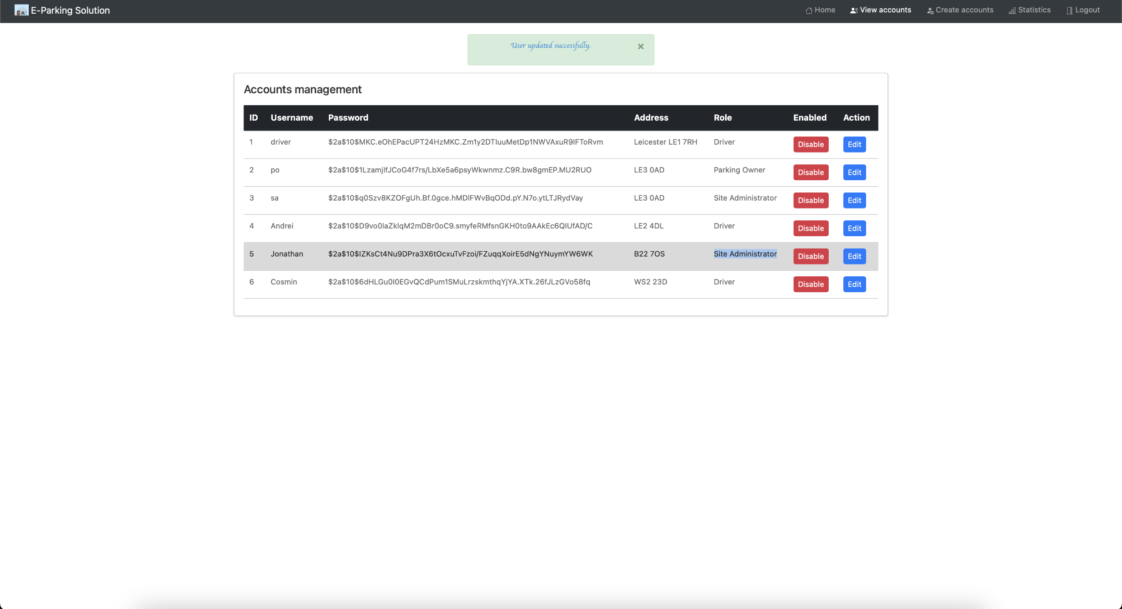
Editing Account (Password and Role

Slide 20
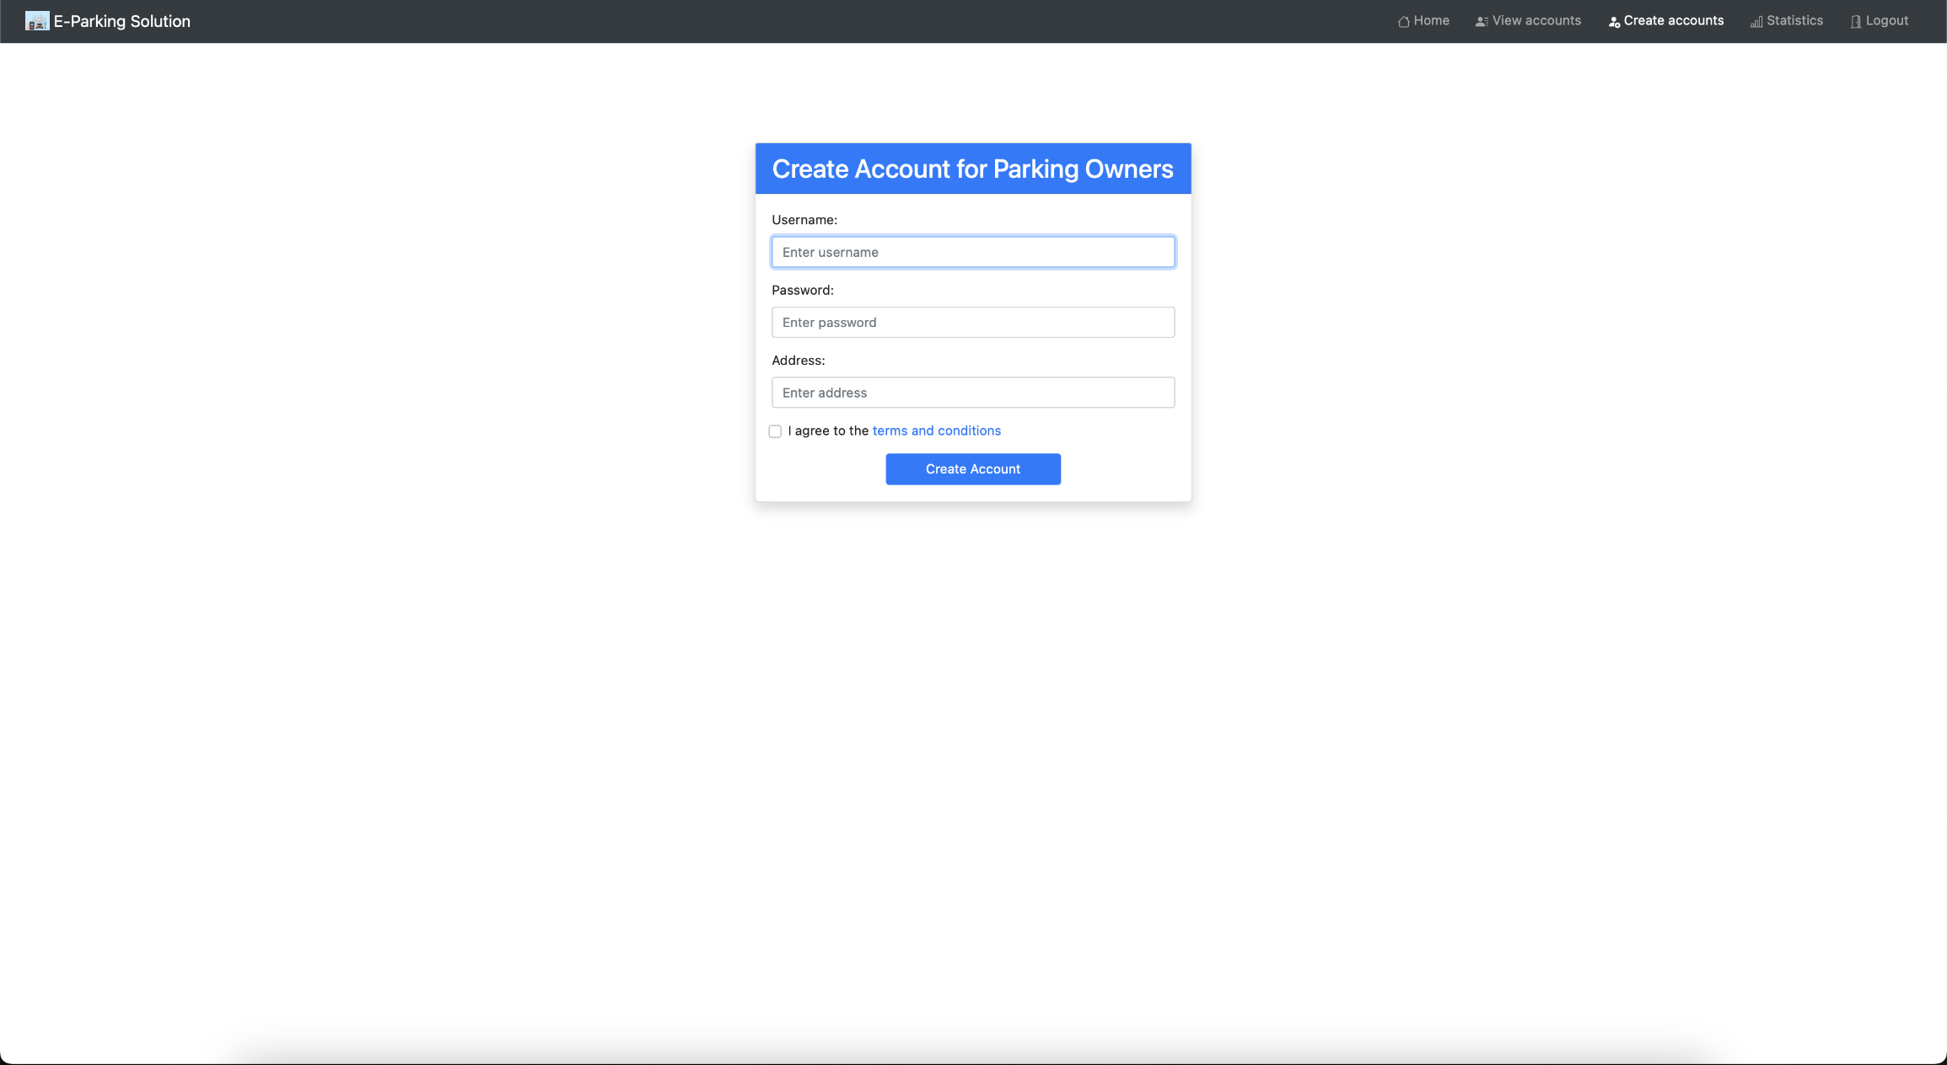
Create Accounts for Parking Owners

Slide 21
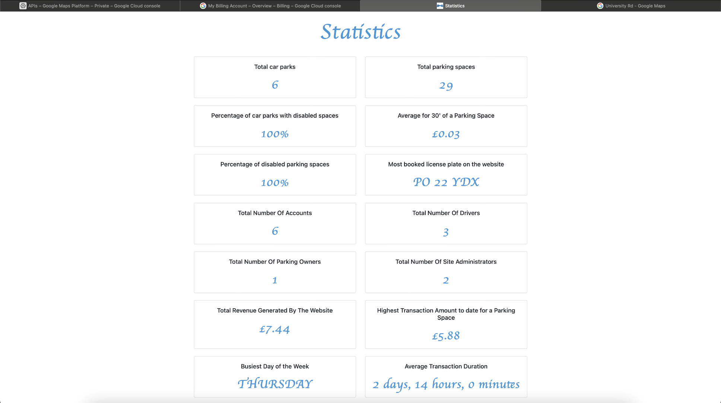
Site Administrator Statistics/Metrics

Slide 22
Thank You For Using Our Service
See You Soon…
Don’t Forget To Give Your Feedback.
Hope You Liked Our Service

